Slide 1
WORKPLACE PROFESSIONAL COMMUNICATION SKILLS

Slide 2
WPCS Module Assessment
1) Internship Letter (10%) – Individual
2) E- Curriculum Vitae (20%) – Individual
3) Documentation (70%) - Group

Slide 3
COMMUNICATION AT WORKPLACE 1 - Elements of communication process - Academic models of communication process
WORKPLACE PROFESSIONAL COMMUNICATION SKILLS

Slide 4

COMMUNICATION

Slide 5
Meaning of Communication
“Communication is a process of passing information, message and understanding from one person to another” – Koonz
“Communication is the transfer of information from sender to receiver through different channels, with information being understood by the receiver” – Shannon
“Communication is a process by which people create and share information with one another in order to reach common understanding” – Rogers

Slide 6
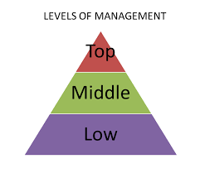
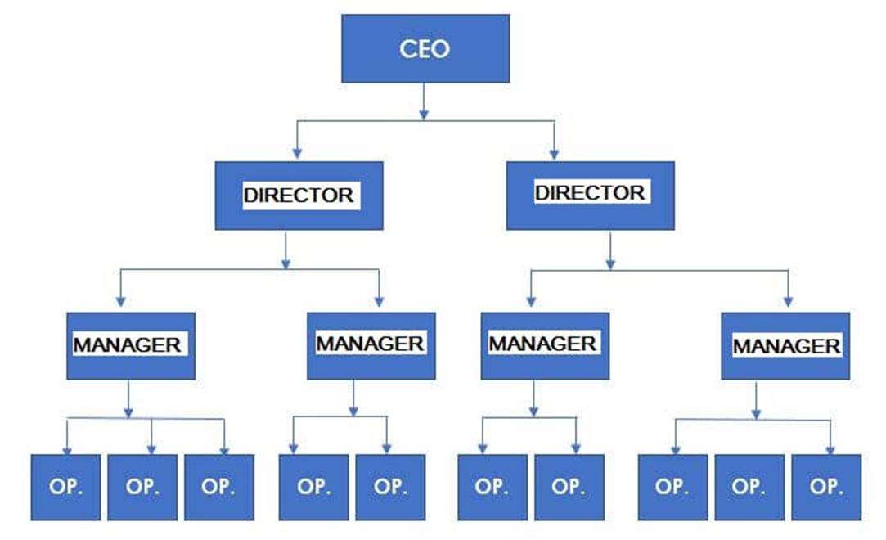
Levels of Management

Slide 7
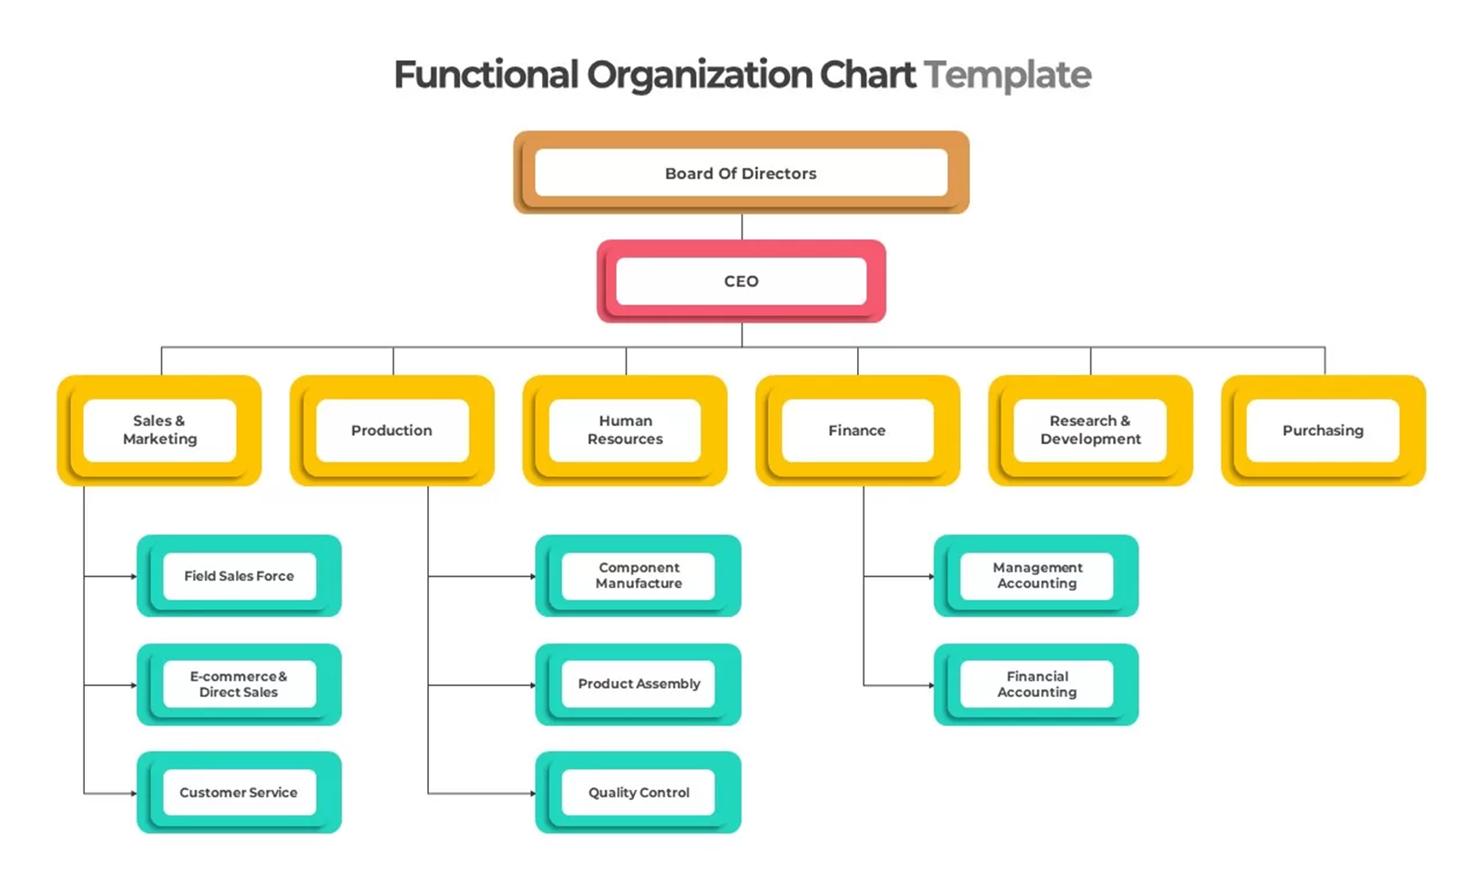

Slide 8
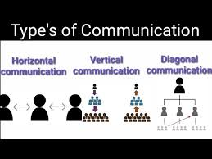

Slide 9
Features of Communication
Minimum two persons
Two- way process
Pervasive function
Continuous function
Oral, written and gestures
Understanding message
Vertical, horizontal and diagonal

Slide 10
Principles of Communication
Clarity
Relevance
Feedback
Empathy
Timeliness
Appropriateness
Accuracy
Attention
Adaptability
Purpose
Respect
Listening

Slide 11
1.Clarity(Be Clear and Concise): Ensure that your message is easily understood. Avoid ambiguity, jargon, or unnecessary complexity, and use simple, direct language to convey your point.
2.Relevance (Know Your Audience): Tailor your message to the interests, needs, and level of understanding of your audience. This makes your communication more engaging and effective.
3.Feedback(Encourage Two-Way Communication): Effective communication is a dialogue, not a monologue. Encourage feedback, ask questions, and listen actively to understand the perspectives of others

Slide 12
4. Empathy(Consider Emotions): Understand and acknowledge the emotions of your audience. Empathy helps in building connections, resolving conflicts, and fostering a positive communication environment.
5. Timeliness(Communicate at the Right Time): Timing is crucial in communication. Deliver your message when it is most relevant and when your audience is most receptive.
6. Appropriateness(Use the Right Medium): Choose the appropriate channel (e.g., face-to-face, email, phone) based on the context, the message's importance, and the preferences of your audience.

Slide 13
7. Accuracy(Be Truthful and Precise): Ensure that the information you share is accurate and truthful. Misleading or incorrect information can lead to misunderstandings, mistrust, and potential harm.
8. Attention(Engage and Focus): Pay attention to the message and the non-verbal cues during communication. Being fully present shows respect and helps in understanding the message more accurately.
9. Adaptability(Be Flexible): Be willing to adjust your communication style and approach based on the situation, feedback received, or changes in the environment. Adaptability is key to effective communication.

Slide 14
10. Purpose( Have a Clear Objective): Know what you want to achieve with your communication. Whether it's to inform, persuade, or entertain, having a clear purpose guides how you structure and deliver your message.
11. Respect(Respect the Audience): Show respect for the opinions, time, and feelings of your audience. This fosters a positive atmosphere and encourages open, honest communication.
12. Listening (Active Listening): Communication is not just about speaking or writing; it's also about listening. Practice active listening to fully understand the message being communicated to you.

Slide 15
Importance of Communication
Acts as a basis of coordination
Acts as a basis of decision making
Increases managerial efficiency
Promotes cooperation and industrial peace
Establishes effective leadership
Boosts morale and provides motivation
Helps in training and development
Helps to maintain public relations

Slide 16
1. Acts as a basis of coordination: An organization has many departments, divisions, sub-divisions, etc., and in order to coordinate the activities of all the departments, communication is essential. Communication helps in the coordination of various activities and provides for the exchange of information, ideas, facts, etc.
2. Acts as a basis of decision making: Communication provides the managers with information and ideas for sound planning and decision making. It enables a manager to analyze the problems and gather information for making sound decisions. Through communication, decisions can be passed to those who are involved in executing them.

Slide 17
3. Increases managerial efficiency: For quick and effective performance of managerial functions, communication is essential. Managers convey goals, instructions, allocate jobs and responsibilities and evaluate performances with the help of communication. Thus, because of communication entire organization is lubricated and works with full efficiency.
4. Promotes cooperation and industrial peace: Cooperation and industrial peace are promoted because of communication by developing understanding between superiors and subordinates. Any misunderstanding or misconception can be easily removed with communication. As communication is a two-way process, an atmosphere of trust and understanding is maintained in the organisation.

Slide 18
5. Establishes effective leadership: Effective communication is needed for guiding, inspiring and motivating employees in an organization. Leaders need to communicate their ideas, thoughts, suggestions, etc., and this can be possible only when there is an effective communication system in an organization. Communication is also needed to know the feelings, responses, problems, grievances and suggestions of the followers.
6. Boosts morale and provides motivation: Motivation and morale of the employees largely depend on the effectiveness of the communication system. Communication helps in keeping the employees informed about plans, policies, procedures, etc., and with such information, employees get a sense of belongingness. Good communication develops the confidence and trust of workers and enables leaders to motivate, influence and satisfy their subordinates.

Slide 19
7. Helps in training and development: Communication plays a vital role in the training and development of employees at every level of management. The degree of learning in a training depends not only on the contents of the training and development programme but also on how the knowledge and skills are being transmitted.
8. Helps to maintain public relations: An organisation has to deal with both the internal and external world, which includes customers, investors, trade unions, government, etc. Organisations are required to maintain healthy and cordial relations with everyone. It must always strive to convince the public that its actions are in interests of society.

Slide 20
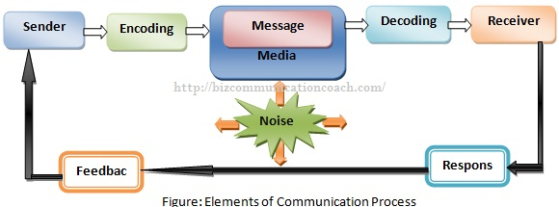
Elements of Communication Process

Slide 21
Steps/Elements of Communication Process
1. Sender
The person who conveys his thoughts, message or ideas to the receiver is known as the sender. The sender has some kind of information, a command, request, or idea that he or she wants to share with others.. E.g., In a classroom, a teacher is a sender.
2. Encoding
The process of converting messages into communication symbols, which may be understood by the receiver. It includes words, pictures, gestures, symbols, etc. Encoding translates the internal thought of the sender into a language which can be understandable.

Slide 22
3. Message
The subject matter of communication is termed as messages. The message or content is the information that the sender wants to relay to the receiver It includes ideas, feelings, suggestions, order, etc., which a sender wants to convey to the receiver
4. Media
The path, channel or medium through which encoded message is transmitted to the receiver is known as media. It is the carrier of the message. It can be in written form, face to face, through telephone, letter, internet, etc.

Slide 23
5. Decoding
The process of translating the encoded message into an effective language, which can be understood by the receiver is known as decoding. In this, the encoded symbols of the sender are converted.
6. Receiver
The person who receives the message of the sender is known as the receiver. E.g., Students are receivers in the classroom.

Slide 24
7. Feedback
In order to complete the process of communication, feedback is essential. The process of reversal of communication in which the receiver expresses his reaction to the sender of the message is known as feedback. Feedback ensures that the receiver has received and understood the message.
8. Noise
Any construction or hindrance which hampers the communication process is known as noise. The hindrance may be caused to the sender, message or receiver. It acts as a barrier to effective communication and because of this message is interpreted differently by the receiver. Disturbance in the telephone line, inattentive receiver, faulty decoding, poor internet connection, improper gestures and postures, etc., are some examples of noise.

Slide 25
Academic models of communication process

Slide 26
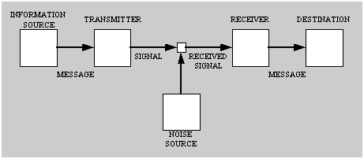
1) Shannon's (1948) Model of the communication process.

Slide 27
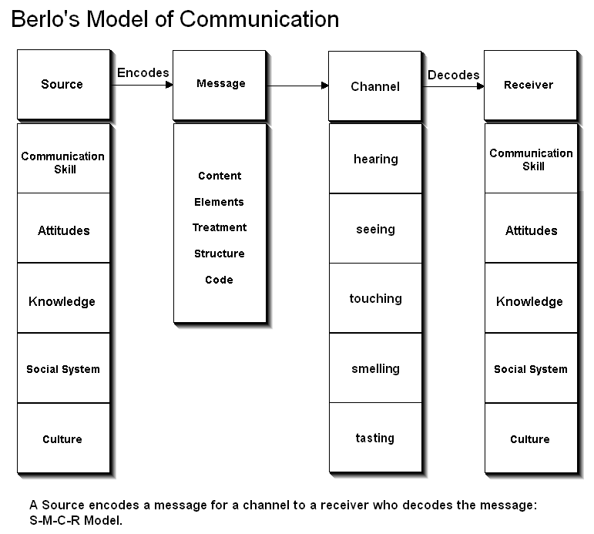
2) Berlo’s Model of Communication

Slide 28
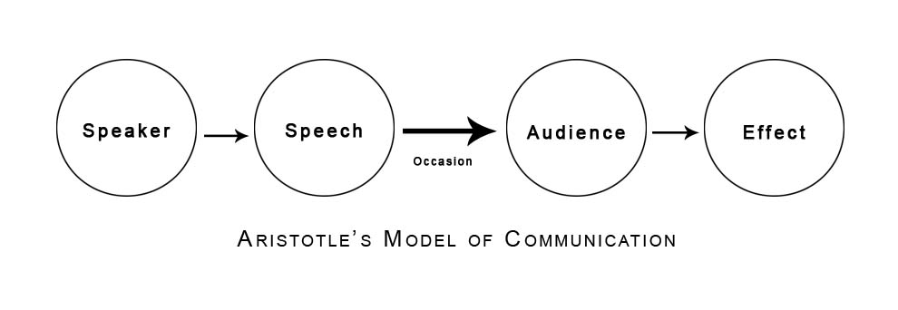
3) Aristotle's Model of Communication

